Slide 1


Slide 2
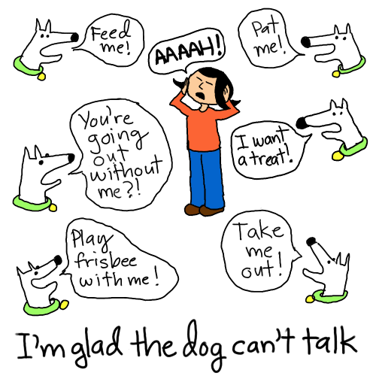
If we report what another person has said, we usually do not use the speaker’s exact words (direct speech), but reported speech (indirect) .

Slide 3
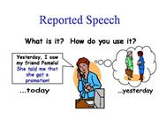
When transforming statements, check whether you have to change:
pronouns
present tense verbs (3rd person singular)
place and time expressions
tenses (backshift)

Slide 4
Example
direct speech
“I speak English.”
English.reported speech
He said that he spoke English.

Slide 5
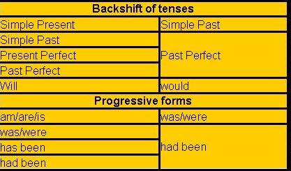

Slide 6
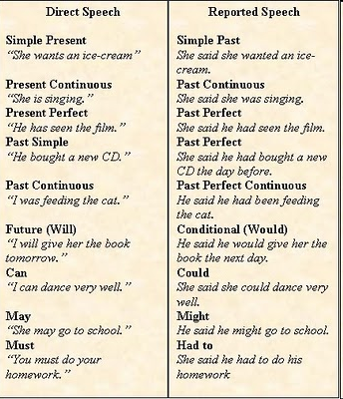

Slide 7
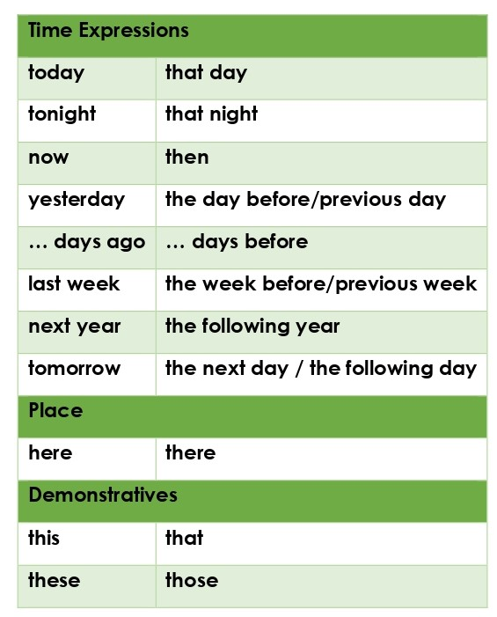

Slide 8


Slide 9
Rewrite the sentences in reported speech. Change pronouns and time expressions where necessary.
She said, "I am reading."
→ She said that ____________________
They said, "We are busy."
→ They said that ___________________
He said, "I know a better restaurant."
→ He said that _____________________
She said, "I woke up early."
→ She said that ____________________
He said, "I will ring her."
→ He said that _____________________

Slide 10
They said, "We have just arrived."
→ They said that _________________
He said, "I will clean the car."
→ He said that ___________________
She said, "I did not say that."
→ She said that __________________
She said, "I don't know where my shoes are."
→ She said that __________________
He said: "I won't tell anyone."
→ He said that ____________________

Slide 11
REPORTING QUESTIONS
"Where is my umbrella?" she asked.
→ She asked _______________________
"How are you?" Martin asked us.
→ Martin asked us ___________________
He asked, "Do I have to do it?"
→ He asked ________________________
"Where have you been?" the mother asked her daughter.
→ The mother asked her daughter ________
"Which dress do you like best?" she asked her boyfriend.
→ She asked her boyfriend _______________

Slide 12
"What are they doing?" she asked.
→ She wanted to know ________________
"Are you going to the cinema?" he asked me.
→ He wanted to know _________________
The teacher asked, "Who speaks English?"
→ The teacher wanted to know __________
"How do you know that?" she asked me.
→ She asked me ______________________
"Has Caron talked to Kevin?" my friend asked me.
→ My friend asked me __________________

Slide 13
When transforming questions,also note that you have to:
transform the question into an indirect question
use the interrogative or if / whether

Slide 14
Interrogative direct speech
“Why don’t you speak English?”
reported speech
He asked me why I didn’t speak English
Direct:
“Do you speak English?”
reported speech:
He asked me whether / if I spoke English.
Online quiz

