Slide 1
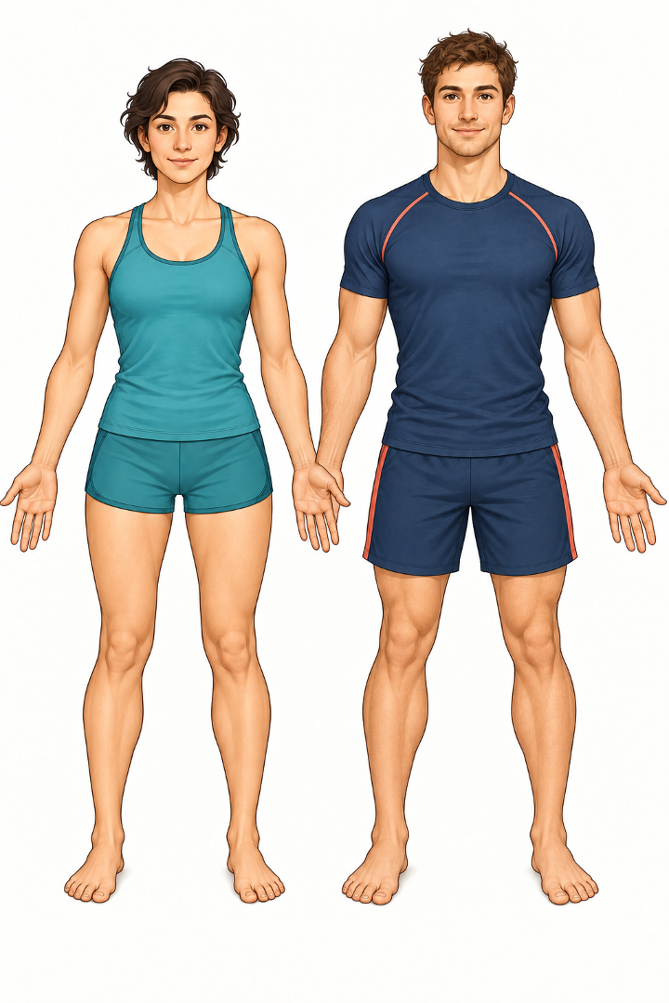
Advanced Human Body Vocabulary
Anatomy terms for healthcare students
Bones and muscles
Internal organs
Anatomical directions
Body movements
Notes:
Source vocabulary: attached Human Body Vocabulary PDF.

Slide 2
Head and face anatomy
Precise external and skeletal terms
1
skull
5
cheekbone
2
4
1
3
5
6
8
7
2
scalp
6
nasal septum
3
temple
7
mandible
4
crown
8
maxilla
Notes:
Source vocabulary: attached Human Body Vocabulary PDF.

Slide 3
Shoulder, arm and hand anatomy
Bones and regions of the upper limb
1
clavicle
5
radius
2
1
4
3
2
6
scapula
ulna
5
6
3
axilla
7
metacarpal
7
8
4
humerus
8
phalanges
Notes:
Source vocabulary: attached Human Body Vocabulary PDF.

Slide 4
Thorax, pelvis and spine
Key landmarks of the trunk
1
sternum
5
spinal column
1
2
2
rib cage
6
lumbar region
5
3
6
7
4
8
3
thorax
7
sacrum
4
pelvis
8
coccyx
Notes:
Source vocabulary: attached Human Body Vocabulary PDF. Posterior terms are shown as vocabulary landmarks on a front-view figure.

Slide 5
Lower limb anatomy
Bones, muscles and tendons of the leg and foot
1
femur
5
Fibula/ calf
2
quadriceps
6
Achilles tendon
3
patella
7
Metatarsal / instep/ arch of the foot
2
1
3
4
4
Tibia/ shin
8
ball of the foot
5
6
7
8
Notes:
Source vocabulary: attached Human Body Vocabulary PDF.

Slide 6
Muscles, tissues and joints
Terms that occur frequently in clinical descriptions
Muscles
Tissues and joints
deltoid muscle
connective tissue
pectoral muscle
subcutaneous tissue
trapezius muscle
synovial joint
latissimus dorsi
joint capsule
gluteus maximus
tendon sheath
Notes:
Source vocabulary: attached Human Body Vocabulary PDF.

Slide 7
Internal organs and vessels
Vocabulary arranged by body region
1
1
brain
6
liver
2
2
trachea
7
stomach
4
3
5
6
3
lung
8
kidney
8
7
9
10
4
9
heart
Small /large intestine
5
diaphragm
10
bladder
Markers indicate approximate body regions, not a diagnostic anatomical diagram.
Notes:
Source vocabulary: attached Human Body Vocabulary PDF. Organ markers show approximate regions only.

Slide 8
Anatomical directions
Paired terms used to describe location
superior
opposite of
inferior
anterior
opposite of
posterior
medial
opposite of
lateral
proximal
opposite of
distal
superficial
opposite of
deep
Notes:
Source vocabulary: attached Human Body Vocabulary PDF.

Slide 9
Body movements
Terms for joint and limb movement
flexion
extension
abduction
adduction
pronation
supination
dorsiflexion
plantar flexion
Notes:
Source vocabulary: attached Human Body Vocabulary PDF.

Slide 10
Advanced vocabulary challenge
Match each term with the correct English definition
1 clavicle
2 mandible
3 sternum
4 patella
5 tibia
6 sacrum
7 axilla
8 phalanges
9 diaphragm
10 proximal
A muscle below the lungs
B kneecap
C breastbone
D lower jawbone
E collarbone
F finger or toe bones
G nearer to the trunk
H shinbone
I armpit
J bone at the base of the spine
Compare answers in pairs before revealing the key
Notes:
Source vocabulary: attached Human Body Vocabulary PDF.

Slide 11
Answer key
1 E
2 D
3 C
4 B
5 H
6 J
7 I
8 F
9 A
10 G
Clinical language check
Choose three terms.
Define each term in English.
Use one term in a clinical sentence.
Notes:
Source vocabulary: attached Human Body Vocabulary PDF.

